Slide 1

Application layer: overview
Principles of network applications
Socket programming with UDP and TCP
Application architectures
Web and HTTP
E-mail, SMTP, IMAP
The Domain Name System DNS

Slide 2
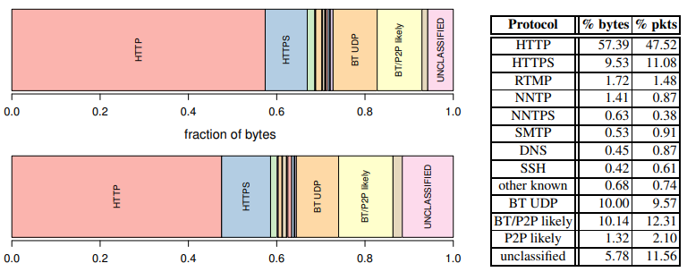
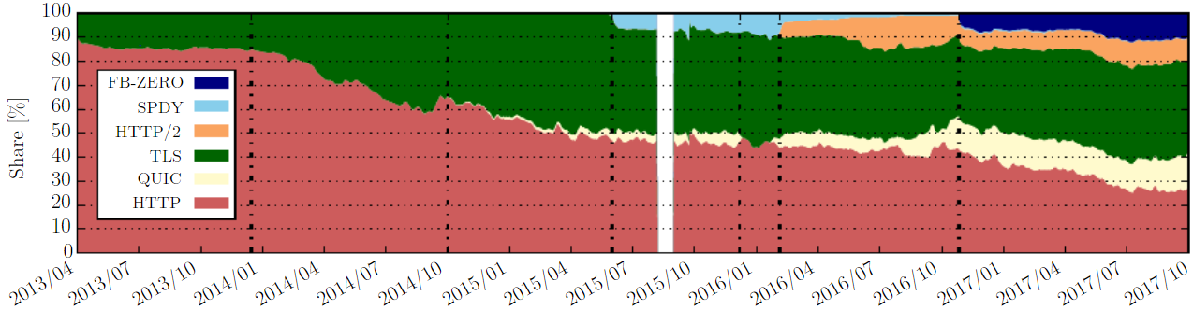
Web and HTTP
HTTP and HTTPS (TLS) account for 70% of the total internet traffic!
https://people.csail.mit.edu/richterp/richter_pam15.pdf
https://blog.apnic.net/2019/01/24/five-years-at-the-edge-recording-the-evolution-of-web-usage-from-an-isp/

Slide 3
Web and HTTP
web pages consist of objects, where an object can be HTML file, JPEG image, Java applet, audio file,…
most web pages consist of a base HTML-file and several referenced objects
The base HTML file references the other objects in the page with the objects’ URLs.
each object is addressable by a URL, e.g.,
www.someschool.edu/someDept/pic.gif
host name
path name

Slide 4
A web page can consist of many different files
Harry Potter Movies
As you all know,
the new HP book
will be out in June
and then there will
be a new movie
shortly after that…
“Harry Potter and
the Bathtub Ring”
hpface.jpg
page.html
castle.gif
It has three objects: the base HTML file and the two images

Slide 5


HTTP overview
HTTP: hypertext transfer protocol
Web’s application layer protocol
client/server model:
client: browser that requests, receives, (using HTTP protocol) and “displays” Web objects
server: Web server sends (using HTTP protocol) objects in response to requests
HTTP request
PC running
Firefox browser
HTTP response
HTTP request
server running
Apache Web
server
HTTP response
iPhone running
Safari browser
Notes:
HTTP is implemented in two programs: a client program and a server program. The client program and server program, executing on different end systems, talk to each other by exchanging HTTP messages. HTTP defines the structure of these messages and how the client and server exchange the messages.
When a user requests a Web page (for example, clicks on a hyperlink), the browser sends HTTP request messages for the objects in the page to the server. The server receives the requests and responds with HTTP response messages that contain the objects.
The Web uses the client-server application architecture, as described before. A Web server is always on, with a fixed IP address, and it services requests from potentially millions of different browsers.

Slide 6
HTTP overview (continued)
HTTP uses TCP:
client initiates TCP connection (creates socket) to server, port 80
server accepts TCP connection from client
HTTP messages (application-layer protocol messages) exchanged between browser (HTTP client) and Web server (HTTP server)
TCP connection closed
HTTP is “stateless”
server maintains no information about past client requests
aside
protocols that maintain “state” are complex!
past history (state) must be maintained
if server/client crashes, their views of “state” may be inconsistent, must be reconciled
Notes:
HTTP uses TCP as its underlying transport protocol (rather than running on top of UDP).

Slide 7
HTTP connections: two types
Non-persistent HTTP
at most one object sent over TCP connection
TCP connection then closed
downloading multiple objects required multiple connections
Persistent HTTP (Keep-alive)
multiple objects can be sent over single TCP connection between client, and that server
Notes:
HTTP persistent connection is also called HTTP keep-alive.

Slide 8
Non-persistent HTTP: example
User enters URL:
www.someSchool.edu/someDepartment/home.index
(this is the URL for the base HTML file; containing text and references to 10 jpeg images)
1a. HTTP client initiates TCP connection to HTTP server (process) at www.someSchool.edu on port 80
1b. HTTP server at host www.someSchool.edu waiting for TCP connection at port 80 “accepts” connection, notifying client
2. HTTP client sends HTTP request message (containing URL) into TCP connection socket. Message indicates that client wants object someDepartment/home.index
3. HTTP server receives request message, forms response message containing requested object, and sends message into its socket
time

Slide 9
Non-persistent HTTP: example (cont.)
User enters URL:
www.someSchool.edu/someDepartment/home.index
(this is the URL for the base HTML file; containing text and references to 10 jpeg images)
4. HTTP server closes TCP connection.
5. HTTP client receives response message containing html file, parse html file, and finds references to the 10 jpeg objects
In this example, when the user requests the web page, 11 TCP connections are generated (one for each object).
6. Steps 1-5 are then repeated for each of the referenced jpeg objects
time
Notes:
The steps above illustrate the use of non-persistent connections, where each TCP connection is closed
after the server sends the object—the connection does not persist for other objects. Note that each TCP
connection transports exactly one request message and one response message.

Slide 10
Non-persistent HTTP: response time
Round-trip time (RTT) definition: the time it takes for a small packet to travel from client to server and back to the client
HTTP response time (per object):
one RTT to initiate TCP connection
one RTT for HTTP request and first few bytes of HTTP response to return
This assumes that the HTTP request message and the third part of the three-way handshake (ACK) are sent together.
object/file transmission time
initiate TCP
connection
RTT
request file
RTT
time to
transmit
file
file received
time
time
Non-persistent HTTP response time = 2RTT+ file transmission time
Concurrent (parallel) TCP connections can be used to make things faster.
Notes:
The first two parts of the three-way handshake take one RTT. After completing the
first two parts of the handshake, the client sends the HTTP request message combined with the third part of the three-way handshake (the acknowledgment) into the TCP connection. Once the request message arrives at the server, the server sends the HTML file into the TCP connection. This HTTP request/response eats up another RTT.

Slide 11
Persistent HTTP (HTTP 1.1)
Non-persistent HTTP issues:
requires 2 RTTs per object
OS overhead for each TCP connection
browsers often open multiple parallel TCP connections to fetch referenced objects in parallel
Persistent HTTP (HTTP1.1):
server leaves connection open after sending response
subsequent HTTP messages between same client/server sent over open connection
client sends requests as soon as it encounters a referenced object
as little as one RTT for all the referenced objects

Slide 12

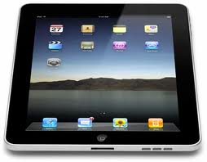
Persistent HTTP: jumping to steps 4/5
4. HTTP server sends a response.
Server keeps the TCP connection alive.
5. HTTP client receives response message containing html file, displays html. Parsing html file, finds 10 referenced jpeg objects
time
The 10 objects can be requested over the same TCP connection.
i.e., save an RTT trying to open a new TCP connection per object.

Slide 13
Persistent HTTP (HTTP 1.1)
The “persistent HTTP” approach, also called HTTP keep-alive, can re-use the same TCP connection to send and receive multiple HTTP requests/responses, one after another, serially.
Amortizes TCP overhead, but maintains TCP state longer at server.
Persistent With Pipelining
The “pipelining” feature in HTTP 1.1 allows to send successive requests, over the same persistent connection, without waiting for replies to pending requests.
When the server receives the successive requests, it sends the objects in a successive manner.

Slide 14
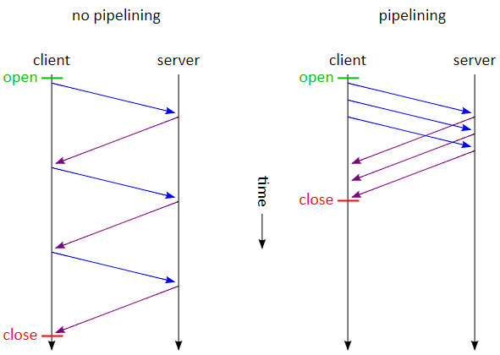
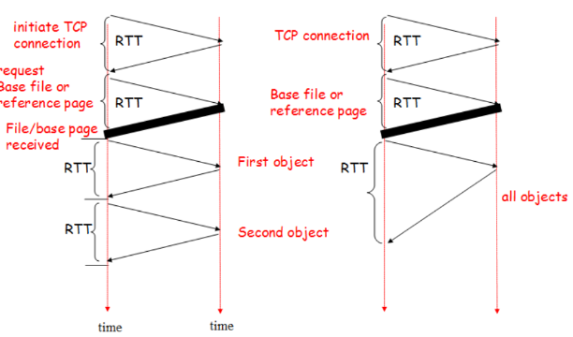
Persistent HTTP with Pipelining
Persistent Without Pipelining
Client issues new request only when previous response has been received.
One RTT for each referenced object.
Persistent With Pipelining
Default in HTTP/1.1
Client sends requests as soon as it encounters a referenced object.
As little as one RTT for each referenced object.

Slide 15
Non-persistent HTTP vs Persistent HTTP
Additional reading material:
https://perso.telecom-paristech.fr/dufourd/cours/pesto/http.html#/16
When you click this link, you will see two figures. The left figure illustrates the non-persistent HTTP while the right figure illustrates the persistent HTTP.
The following link gives the illustration for persistent HTTP with pipelining.
https://perso.telecom-paristech.fr/dufourd/cours/pesto/http.html#/17

Slide 16
HTTP request message
two types of HTTP messages: request, response
HTTP request message:
ASCII (human-readable format)
carriage return character
line-feed character
request line (GET, POST,
HEAD commands)
GET /index.html HTTP/1.1\r\n
Host: www-net.cs.umass.edu\r\n
User-Agent: Firefox/3.6.10\r\n
Accept: text/html,application/xhtml+xml\r\n
Accept-Language: en-us,en;q=0.5\r\n
Accept-Encoding: gzip,deflate\r\n
Accept-Charset: ISO-8859-1,utf-8;q=0.7\r\n
Keep-Alive: 115\r\n
Connection: keep-alive\r\n
\r\n
header
lines
carriage return, line feed at start of line indicates end of header lines

Slide 17
HTTP request message: general format
method
sp
URL
sp
version
cr
lf
request
line
header field name
value
cr
lf
~
~
header
lines
~
~
header field name
value
cr
lf
cr
lf
~
entity body
~
body
~
~

Slide 18
Other HTTP request methods
POST method:
web page often includes form input
user input is sent from client to server in entity body of HTTP POST request message
HEAD method:
similar to the GET method but asks the server to leave out the requested object
Often used for debugging
PUT method:
uploads new file (object) to server
completely replaces file that exists at specified URL with content in entity body
GET method (for sending data to server):
include user data in URL field of HTTP GET request message (following a ‘?’):
www.somesite.com/animalsearch?monkeys&banana

Slide 19
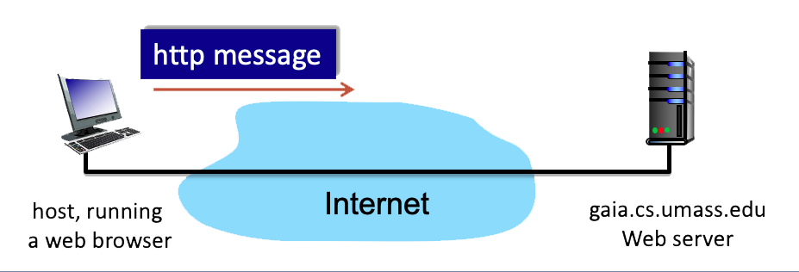
HTTP request message - Quiz
Consider the figure above, where a client is sending an HTTP GET message to a web server, gaia.cs.umass.edu. Suppose the client-to-server HTTP GET message is given below.
GET /kurose_ross_sandbox/interactive/quotation8.htm HTTP/1.1 Host: gaia.cs.umass.edu Accept: text/plain, text/html, image/jpeg, image/gif, audio/basic, audio/vnf.wave, video/mpeg, video/wmv, Accept-Language: en-us, en-gb;q=0.1, en;q=0.3, fr, fr-ch, zh, da, fi, ar, cs If-Modified-Since: Mon, 10 Aug 2020 14:02:13 -0700 User Agent: Mozilla/5.0 (Windows NT 6.1; WOW64) AppleWebKit/535.19 (KHTML, like Gecko) Chrome/18.0.1025.168 Safari/535.19

Slide 20
HTTP request message - Quiz
1. What is the name of the file that is being retrieved in this GET message? 2. What version of HTTP is the client running? 3. True or False: The client will accept html files 4. True or False: The client will accept jpeg images 5. What is the client's preferred version of English? 6. What is the client's least preferred version of English? 7. True or False: The client will accept the German language 8. True or False: The client already has a cached copy of the file

